Slide 1



Project Overview: Food Deserts
Project 3: Visualizing Data
We will identify locations that have very few grocery stores serving a large population (also known as Food Desert) and determine the factors that contribute toward the situation.
The GAP Team:
Godkindhi, Avoaka, Purwanto
Notes:
Shailesh

Slide 2


Project 3: Visualizing Data
Project Overview: Mapping Food Deserts
We will identify locations that have very few grocery stores serving a large population (also known as Food Deserts) and determine the factors that contribute toward the situation.
The GAP Team:
Godkindhi, Avoaka, Purwanto
HEALTHY FOOD SCARCITY
POPULATION
Does a low-income population lead to a food desert?
Does the number of fast-food places correlate with population?
Why Food Deserts?
Notes:
Shailesh

Slide 3
Our Process
Project 3: Visualizing Data
Project Overview: Food Deserts
01
DATA SOURCES
04
DATABASE
Census Bureau
FRED
Georgia Dep. Of Education
Google Maps API
Prostgre SQL
Plan & Construct Schema
02
PROGRAMMING
05
VISUALIZATIONS
We will identify locations that have very few grocery stores serving a large population (also known as Food Desert) and determine the factors that contribute toward the situation.
Python
Plotly
Dash
JavaScript
Bar-Line Combo Chart
Stacked Bar Chart
Scatter Plot
Heat Map
HEALTHY FOOD SCARCITY
Why Food Deserts?
POPULATION
Does a low-income population lead to a food desert?
Does the number of fast-food places correlate with population?
03
DATA MUNGING
06
WEB DEVELOPMENT
Combine
Sort
Clean (Remove Duplicates and Drop Columns)
Launch a web page using Flask
Plot locations on a map using Leaflet
Notes:
Shailesh

Slide 4

Our Process
01
DATA SOURCES
04
DATABASE
Census Bureau
FRED
Georgia Dep. Of Education
Google Maps API
Prostgre SQL
Plan & Construct Schema
Data Gathering and Analysis
02
PROGRAMMING
05
VISUALIZATIONS
Python
Plotly
Dash
JavaScript
Bar-Line Combo Chart
Stacked Bar Chart
Scatter Plot
Heat Map
HEALTHY FOOD SCARCITY
POPULATION
Does a low-income population lead to a food desert?
Does the number of fast-food places correlate with population?
03
DATA MUNGING
06
WEB DEVELOPMENT
Combine
Sort
Clean (Remove Duplicates and Drop Columns)
Launch a web page using Flask
Plot locations on a map using Leaflet
Why Food Deserts?
Notes:
Shailesh

Slide 5
Data Analysis Process Steps
Our Process
Project 3: Data Visualizations
03
Use APIs
4 Charts
Using Foursquare APIs we got the location and names of:
Grocery Stores
Dollar Stores
Fast Food Places
Must be within a radius of 5-6 miles of County
01
DATA SOURCES
DATABASE
Census Bureau
FRED
Georgia Dep. Of Education
Google Maps API
01
Choose Counties
Prostgre SQL
Plan & Construct Schema
We chose 15 counties based Urban / Rural, Per Capita Income and % FRL (Percentage of School Students receiving Free or Reduced Price Lunch)
% FRL – This has been considered as good indicator of poverty in a given area.
Following websites were used to get the Income and FRL data:
https://fred.stlouisfed.org/
https://oraapp.doe.k12.ga.us
VISUALIZATIONS
04
Bring this data into separate Panda Data Frame for Grocery Stores, Dollar Stores and Fast Food Places
Perform Totals for each category per County
Store this data in our PostgreSQL Database and JSON files.
Data Gathering and Analysis
PROGRAMMING
05
VISUALIZATIONS
Python
Plotly
Dash
JavaScript
Bar-Line Combo Chart
Stacked Bar Chart
Scatter Plot
Heat Map
05
WEB DEVELOPMENT
Create Bar Graphs and Scatter Plots mapping the data
Create Heat Maps for showing distribution of Grocery Stores, Dollar Stores and Fast Food Places
02
03
DATA MUNGING
06
WEB DEVELOPMENT
Combine
Sort
Clean (Remove Duplicates and Drop Columns)
02
Get Location Info
Launch a web page using Flask
Plot locations on a map using Leaflet
Get the Latitude and Longitude of Counties
We took the Latitude and Longitude of the County Court as the center of each county.

Slide 6

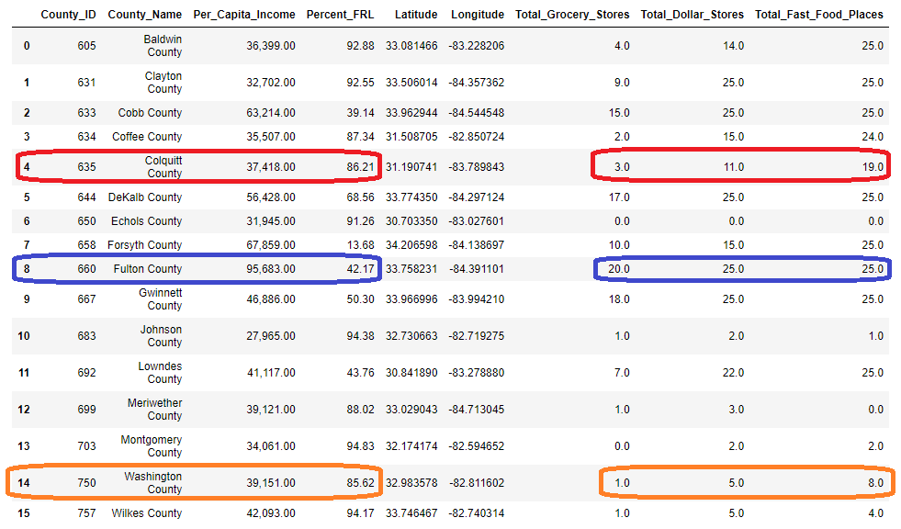
Data Gathering and Analysis
Final County Data Frame
Data Analysis Process Steps
01
Choose Counties
03
Use APIs
We chose 15 counties based Urban / Rural, Per Capita Income and % FRL (Percentage of School Students receiving Free or Reduced Price Lunch)
% FRL – This has been considered as good indicator of poverty in a given area.
Following websites were used to get the Income and FRL data:
https://fred.stlouisfed.org/
https://oraapp.doe.k12.ga.us
Using Foursquare APIs we got the location and names of:
Grocery Stores
Dollar Stores
Fast Food Places
Must be within a radius of 5-6 miles of County
04
VISUALIZATIONS
Bring this data into separate Panda Data Frame for Grocery Stores, Dollar Stores and Fast Food Places
Perform Totals for each category per County
Store this data in our PostgreSQL Database and JSON files.
02
Get Location Info
05
WEB DEVELOPMENT
Get the Latitude and Longitude of Counties
We took the Latitude and Longitude of the County Court as the center of each county.
Create Bar Graphs and Scatter Plots mapping the data
Create Heat Maps for showing distribution of Grocery Stores, Dollar Stores and Fast Food Places

Slide 7
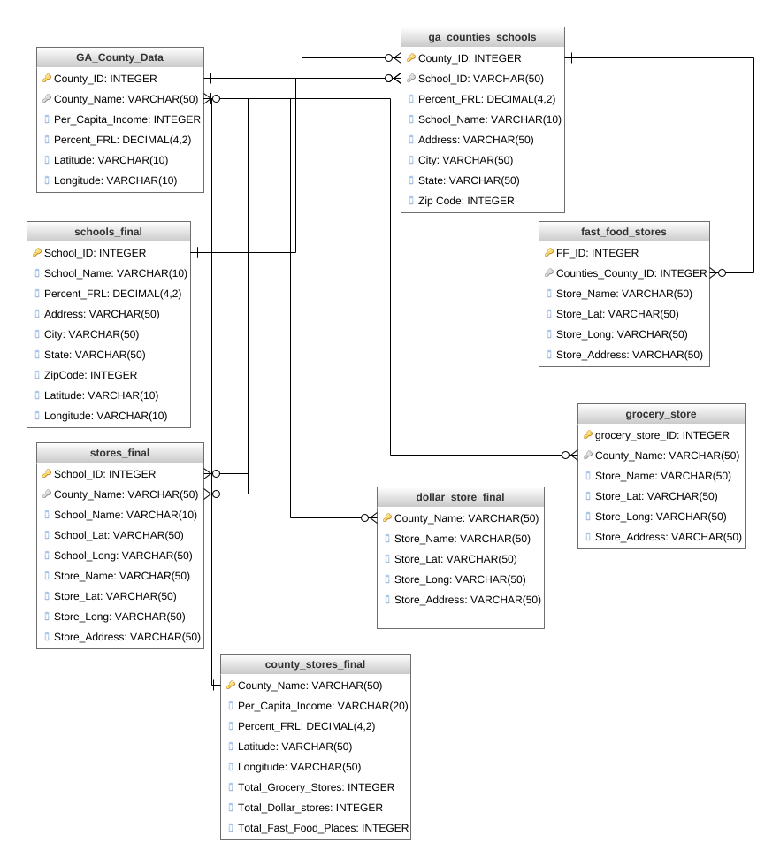
Data Analysis Process Steps
ERD
Our Database Relationship Diagram
03
Use APIs
01
Choose Counties
Using Foursquare APIs we got the location and names of:
Grocery Stores
Dollar Stores
Fast Food Places
Must be within a radius of 5-6 miles of County
Final County Data Frame
We chose 15 counties based Urban / Rural, Per Capita Income and % FRL (Percentage of School Students receiving Free or Reduced Price Lunch)
% FRL – This has been considered as good indicator of poverty in a given area.
Following websites were used to get the Income and FRL data:
https://fred.stlouisfed.org/
https://oraapp.doe.k12.ga.us
04
VISUALIZATIONS
Bring this data into separate Panda Data Frame for Grocery Stores, Dollar Stores and Fast Food Places
Perform Totals for each category per County
Store this data in our PostgreSQL Database and JSON files.
Access the full diagram here:
app.genmymodel.com
05
WEB DEVELOPMENT
02
Get Location Info
Create Bar Graphs and Scatter Plots mapping the data
Create Heat Maps for showing distribution of Grocery Stores, Dollar Stores and Fast Food Places
Get the Latitude and Longitude of Counties
We took the Latitude and Longitude of the County Court as the center of each county.

Slide 8
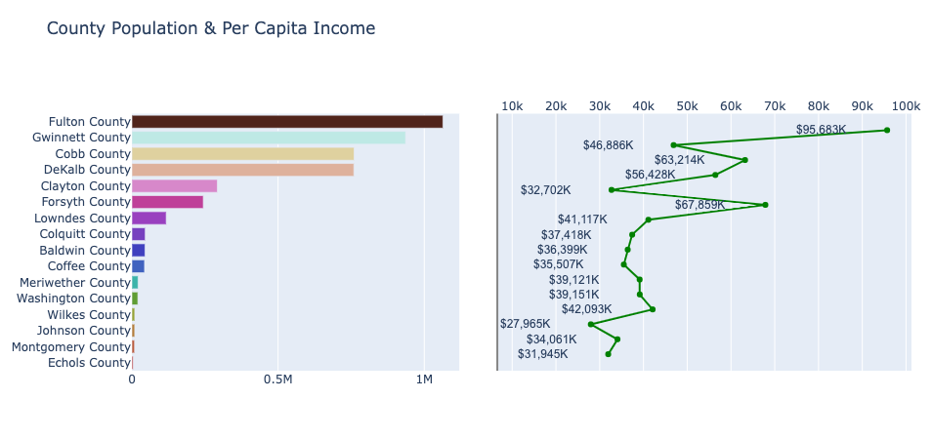
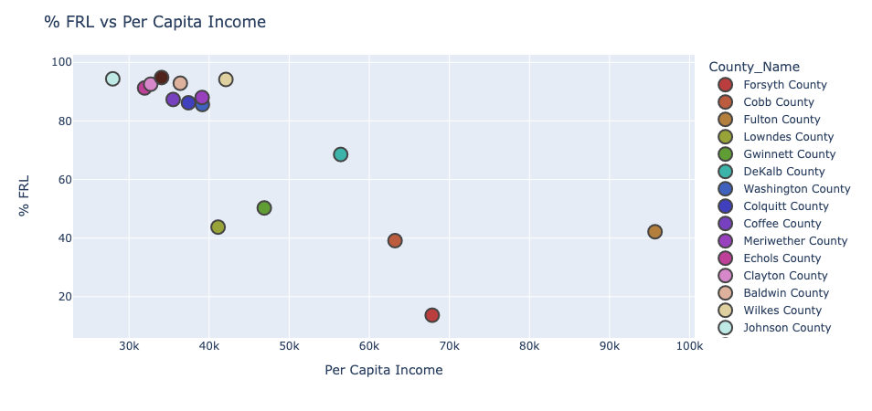
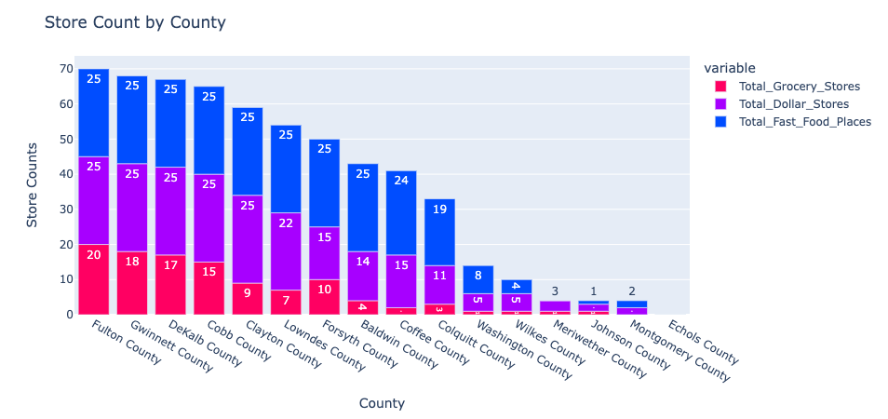
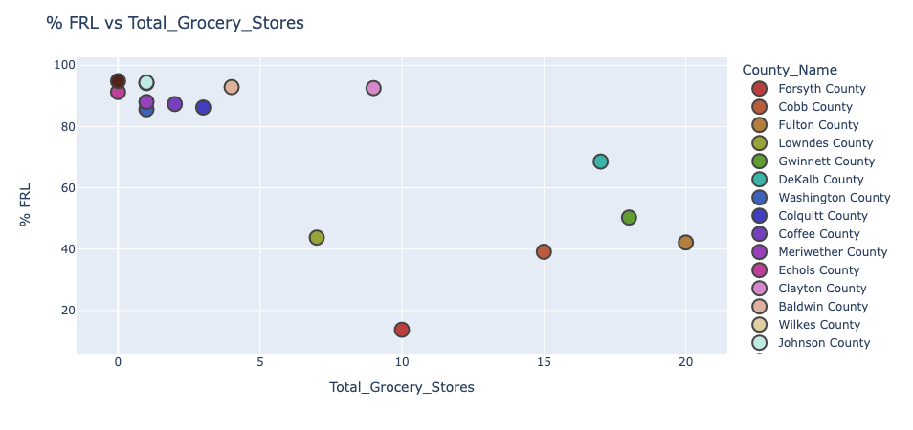
Final County Data Frame
Data Visualizations
ERD
4 Charts
Our Database Relationship Diagram
Access the full diagram here:
app.genmymodel.com
Notes:
Marc

Slide 9
ERD
Data Visualizations
Our Database Relationship Diagram
Chart #1
4 Charts
Access the full diagram here:
app.genmymodel.com
These 2 graphs show the correlation between County Population and Per Capita Income. Counties with a high population tend to have a higher Per Capita Income than those with a lower population.
Notes:
Ellis
With the gathered data which was presented by Shailesh earlier, we’ve made four different graphs to visualize our data.

Slide 10
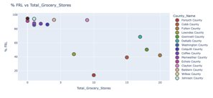
Data Visualizations
4 Charts
Chart #1
Chart #2
These 2 graphs show the correlation between County Population and Per Capita Income. Counties with a high population tend to have a higher Per Capita Income than those with a lower population.
The graph shows that there is a weak negative correlation between a county's % FRL and it's Per Capita Income. There is a cluster of counties located where the % FRL is high and the Per Capita Income level is low. The high % FRL may be due to the low Per Capita Income level of that county. As the Per Capita Income level of a county increases, the % FRL decreases. The low % FRL may be due to the high Per Capita Income level of that county.
Notes:
Ellis
First graph - we compare county population & per capita income
With this graph, we can see the clear correlation between pop & income as they tend to move the same way.
High Population --> (brings about) relatively High Income

Slide 11
Data Visualizations
Chart #1
Chart #3
Chart #2
The graph shows that there is a weak negative correlation between a county's % FRL and it's Per Capita Income. There is a cluster of counties located where the % FRL is high and the Per Capita Income level is low. The high % FRL may be due to the low Per Capita Income level of that county. As the Per Capita Income level of a county increases, the % FRL decreases. The low % FRL may be due to the high Per Capita Income level of that county.
Like Chart #2, this graph shows a weak negative correlation between a county's % FRL and it's Total Grocery Stores. There is a cluster of counties located where the % FRL is high and the Grocery Store count is low. The high % FRL may be due to the low Per Capita Income level of that county. As the Grocery Stores count of a county increases, the % FRL tend to decrease.
These 2 graphs show the correlation between County Population and Per Capita Income. Counties with a high population tend to have a higher Per Capita Income than those with a lower population.
Notes:
Ellis
In this chart, we are comparing the % free reduced lunch with per capita income
There’s weak Negative Correlation as Income ^ FRL v
There’s also high cluster of counties where FRL ^ Income v

Slide 12
Data Visualizations
Chart #3
Chart #2
Chart #4
Like Chart #2, this graph shows a weak negative correlation between a county's % FRL and it's Total Grocery Stores. There is a cluster of counties located where the % FRL is high and the Grocery Store count is low. The high % FRL may be due to the low Per Capita Income level of that county. As the Grocery Stores count of a county increases, the % FRL tend to decrease.
The graph shows that there is a moderate pattern of equal distribution of Fast Food, Dollar and Grocery Stores. There are many confounding variables that may influence this behavior pattern, but one variable may be due to the population of each county. A higher population and/or income may lead to more stores than a lower population and/or income.
The graph shows that there is a weak negative correlation between a county's % FRL and it's Per Capita Income. There is a cluster of counties located where the % FRL is high and the Per Capita Income level is low. The high % FRL may be due to the low Per Capita Income level of that county. As the Per Capita Income level of a county increases, the % FRL decreases. The low % FRL may be due to the high Per Capita Income level of that county.
Notes:
Ellis
Chart 3 similar to chart 2.
They both show Weak Negative Correlation between FRL and the number of grocery stores - Grocery ^ FRL v
There’s also Cluster (although not apparent) - High FRL, Low Grocery Counts

Slide 13
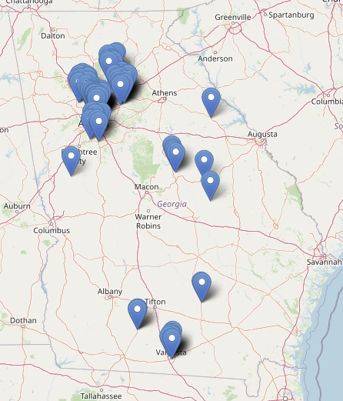
Data Visualizations
Chart #3
Chart #4
Interactive Heat Map
Demonstrated by Shailesh
The graph shows that there is a moderate pattern of equal distribution of Fast Food, Dollar and Grocery Stores. There are many confounding variables that may influence this behavior pattern, but one variable may be due to the population of each county. A higher population and/or income may lead to more stores than a lower population and/or income.
Like Chart #2, this graph shows a weak negative correlation between a county's % FRL and it's Total Grocery Stores. There is a cluster of counties located where the % FRL is high and the Grocery Store count is low. The high % FRL may be due to the low Per Capita Income level of that county. As the Grocery Stores count of a county increases, the % FRL tend to decrease.
Notes:
Ellis
We can see the moderate pattern of equal distribution of stores by population
As you notice, the numbers of each store group tends to go down along with the size of population

Slide 14
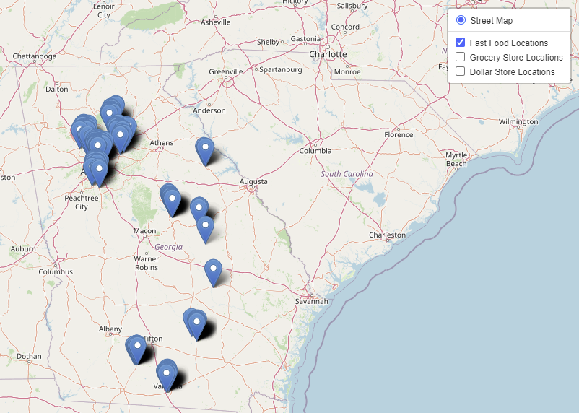

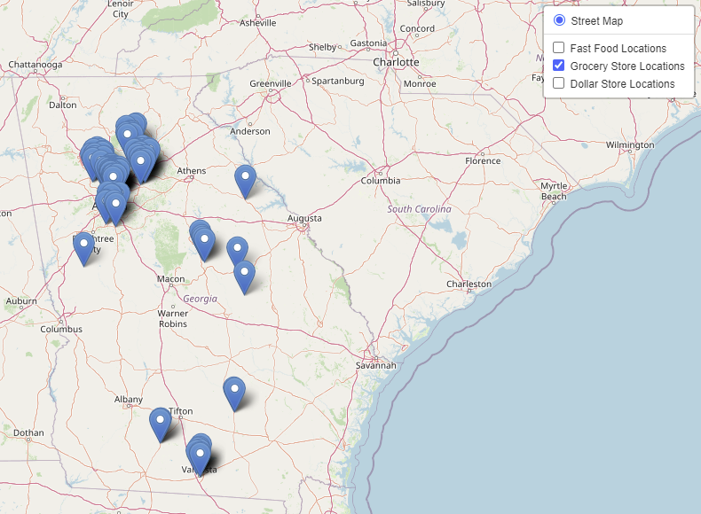
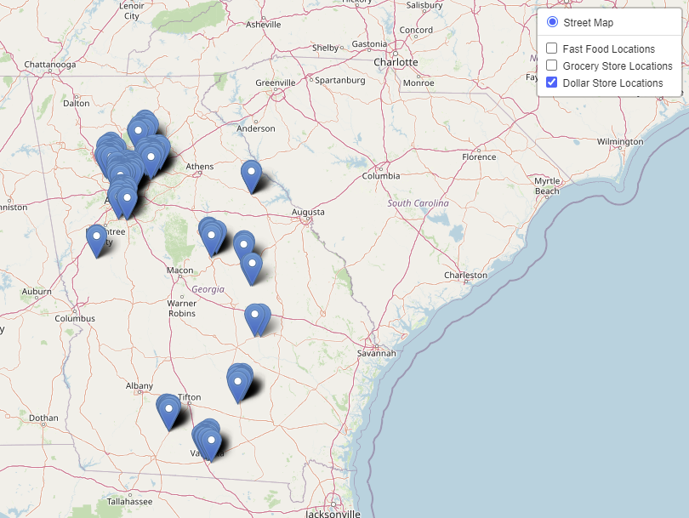
Fast Food Location Map >>
Data Visualization:
Food Deserts
Project 3: Data Visualizations
Chart #4
3 Maps
Data Visualizations
Interactive Heat Map
Demonstrated by Shailesh
Grocery Store Map
Conclusion
Areas with higher levels of poverty are more likely to become Food Deserts. Additionally, poorer countries not only have fewer Grocery stores, but they also have larger numbers of Dollar stores and Fast-Food places proportionate to their population.
Dollar Store Map >>
The graph shows that there is a moderate pattern of equal distribution of Fast Food, Dollar and Grocery Stores. There are many confounding variables that may influence this behavior pattern, but one variable may be due to the population of each county. A higher population and/or income may lead to more stores than a lower population and/or income.
Notes:
Shailesh

Slide 15
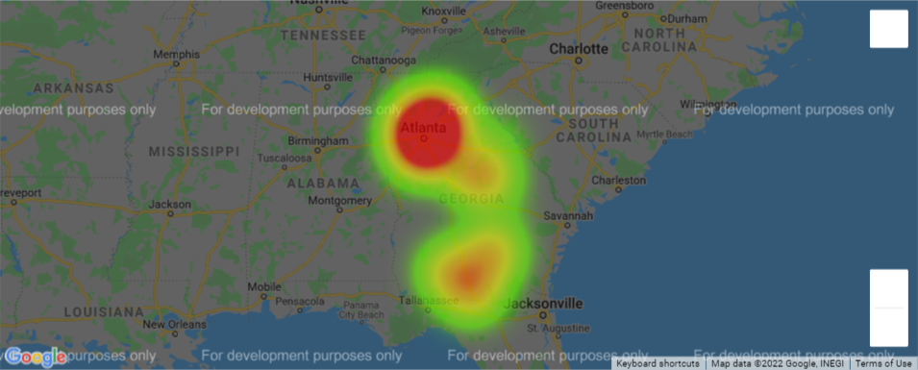
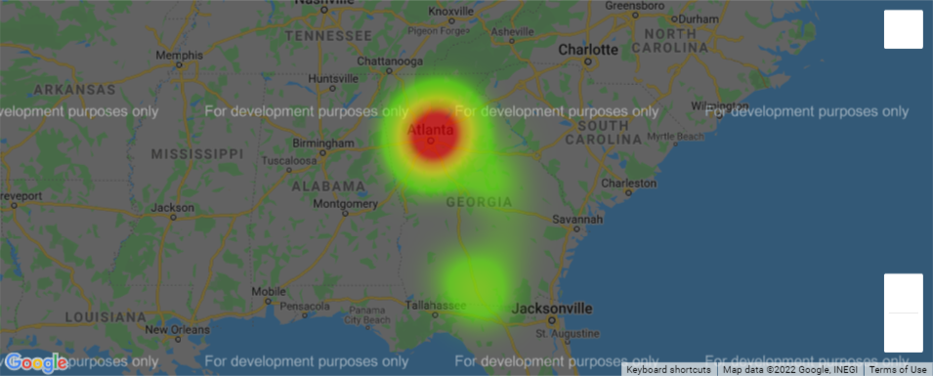
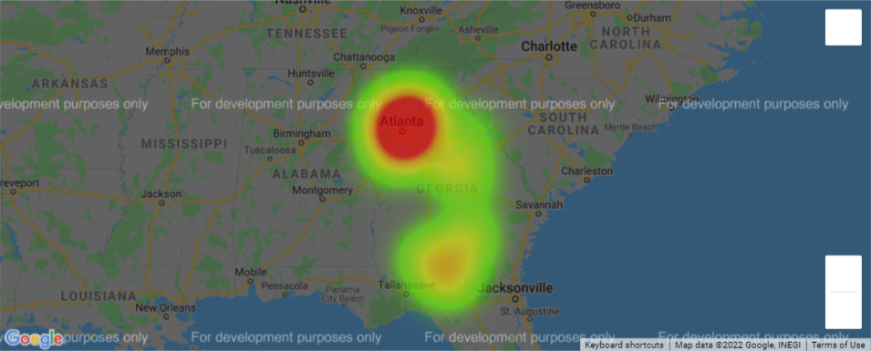
Fast Food Heat Map
Fast Food Location Map >>
Data Visualization:
Food Deserts
3 Heatmaps
3 Maps
Interactive Heat Map
Grocery Store Map
Demonstrated by Shailesh
Dollar Store Map >>
Grocery Store Heat Map
Dollar Store Heat Map
Notes:
Ellis

Slide 16
Fast Food Location Map >>
Data Visualization:
Food Deserts
3 Maps
3 Heatmaps
Fast Food Heat Map
Grocery Store Map
Grocery Store Heat Map
Dollar Store Heat Map
Dollar Store Map >>
Conclusion
Areas with higher levels of poverty are more likely to become Food Deserts. Additionally, poorer countries not only have fewer Grocery stores, but they also have larger numbers of Dollar stores and Fast-Food places proportionate to their population.
Notes:
Ellis

Slide 17
Fast Food Heat Map
Data Visualization:
Food Deserts
3 Heatmaps
Conclusion
Areas with higher levels of poverty are more likely to become Food Deserts. Additionally, poorer counties not only have fewer Grocery stores, but they also have larger numbers of Dollar stores and Fast-Food places proportionate to their population.
Grocery Store Heat Map
Dollar Store Heat Map
Notes:
Shailesh

